Slide 1





K.DHARSHINI
NAAN MUDHALVAN Final Project
1

Slide 2

PROJECT TITLE
HAND GESTURE RECOGNITION
2

Slide 3



AGENDA
Problem statement
Project overview
Solution
Modeling
Results
3/21/2024Annual Review
3

Slide 4

PROBLEM STATEMENT
When people have trouble communicating verbally because of speech impairments or language obstacles, an augmented communication hand gesture detection system can be quite helpful. The goal is to create a simple interface that will allow nonverbal people—such as those with speech impairments or low language skills—to communicate successfully with hand gestures. To enable smooth interpersonal communication, the system should precisely recognize a predetermined set of hand gestures and convert them into matching textual or auditory outputs.
4

Slide 5
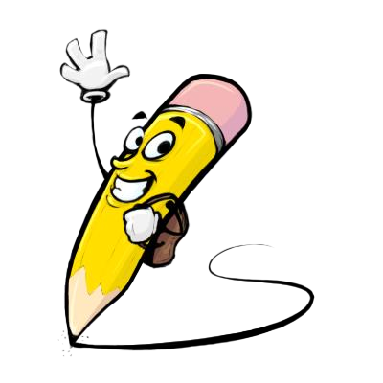
PROJECT OVERVIEW
This project aims to create a hand gesture recognition system using OpenCV and MediaPipe, enabling real-time interpretation of hand movements captured through a webcam
Capture video frames from a webcam or input video source using OpenCV
Utilize the MediaPipe Hand Detection model to identify and localize hand regions within the video frames
Display the video feed with overlaid hand landmarks and recognized gestures in real-time using OpenCV.
5

Slide 6
WHO ARE THE END USERS?
It is still possible to create an accessible and user-friendly hand gesture detection system even when taking into account users who could have cognitive impairments or difficulties.
Individuals with Intellectual Disabilities
Children with Learning Disabilitie
Elderly Individuals
6

Slide 7

YOUR SOLUTION AND ITS VALUE PROPOSITION
Our solution is a user-friendly hand gesture recognition system designed to enable intuitive interaction for individuals with challenges. Leveraging the power of OpenCV and MediaPipe, our system interprets hand gestures captured through a webcam, translating them into meaningful commands or actions
Enhanced Communication
Improved Engagement
Inclusive Design
7

Slide 8

THE WOW IN YOUR SOLUTION
This hand gesture recognition system redefines interaction for individuals with cognitive disabilities, offering intuitive communication and control through simple gestures. With real-time understanding, customization options, and a focus on inclusivity, it empowers users to engage with technology effortlessly, promoting independence, social connection, and a higher quality of life.
8

Slide 9







MODELLING
9

Slide 10
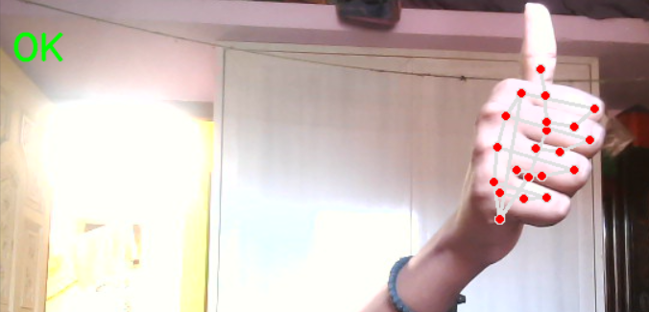
RESULTS
This is a real time output
GitHub link:https://github.com/dharshu2323/TNSDC-GenAI
10

